Slide 1

FOR HOSPITAL DIRECTORS
See every unit’s filter status
without calling AFC for a spreadsheet.
AFC Hospital Portal — your hospital, live, read-only.
On schedule · Due soon · Overdue · Scan the same sticker AFC uses
Advanced Filtration Concepts · 323.832.8316
Notes:
Audience is facilities / plant directors. One line: this is not a sales catalog and not a work-order system. It is live filter status for their hospital, on a phone or desktop, after AFC services the units. 8 more slides.

Slide 2
What changes for you
2 / 9
Today
With the portal
▸ Last service date lives in a binder, a spreadsheet, or somebody’s head.
▸ Overdue units surface when someone walks the penthouse — or after a complaint.
▸ A meeting means calling AFC and waiting on a list.
▸ Your floor staff cannot look a unit up themselves.
▸ Every AHU shows last serviced, next due, and on-schedule / due / overdue.
▸ Home counts the hospital. Needs-attention is the list for this week.
▸ Graphs export to PDF for the meeting. Counts, not dollars.
▸ Your staff scan the same sticker. They see status. They cannot edit it.
AFC Hospital Portal · For hospital directors · 323.832.8316
Notes:
Do not bash their CMMS. Position this as the missing live view of AFC’s filter PM — not a replacement for work orders. The win is: they stop asking us what’s due.

Slide 3
What you are getting
3 / 9
Your hospital only
The login is bound to one facility. There is no hospital picker.
Live unit status
AHU, building, location, last serviced, next due, green / amber / red.
Scan on the floor
Phone camera on the AHU sticker. Same label AFC technicians scan.
Director graphs
Status mix, buildings, completed vs scheduled. Export PDF.
Floor-tech logins
Your people can look units up. No graphs, no prices, no edits.
Read-only on purpose
No catalog, invoices, or job notes. You cannot break the survey.
AFC Hospital Portal · For hospital directors · 323.832.8316
Notes:
This is the ‘what’s in the box’ slide. Username + PIN from AFC. Add to Home Screen on a phone. Session lasts 12 hours. Docs PDF is for their IT if they ask later — don’t drag the packet in unless IS is in the room.

Slide 4
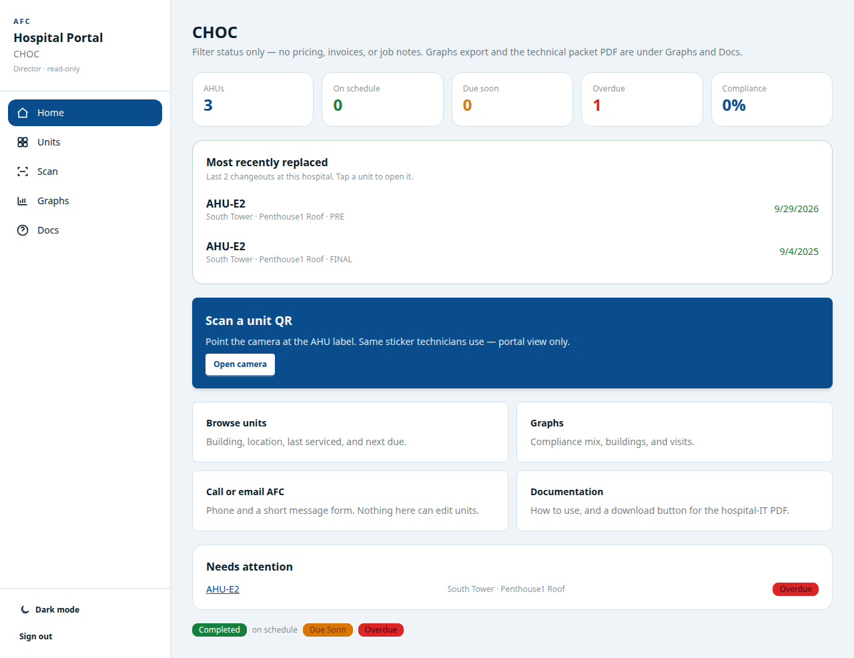
Your hospital at a glance
4 / 9
AFC Hospital Portal · For hospital directors · 323.832.8316
Notes:
Point at the four counts, then Most recently replaced (AFC just did that job — it shows up here), then Needs attention. Scan is the same sticker. Nothing on this screen is a price.

Slide 5
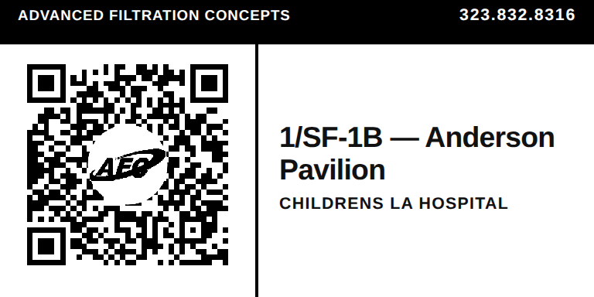
Walk up to a unit. Scan it. Know it.
5 / 9
Last serviced / next due
Dates on the unit, not in a binder.
Stage, size, quantity
PRE, FINAL, gas phase — what is in the machine.
Green, amber, red
On schedule, due soon, or overdue. Instantly.
Same sticker AFC uses
You see status. Our tech sees the job. You cannot edit it.
AFC Hospital Portal · For hospital directors · 323.832.8316
Notes:
If you have a physical sticker, hold it up. AFC tech scan = job. Director/hospital scan = status. Same QR, different door. Unit page is read-only — no part numbers, no prices.

Slide 6
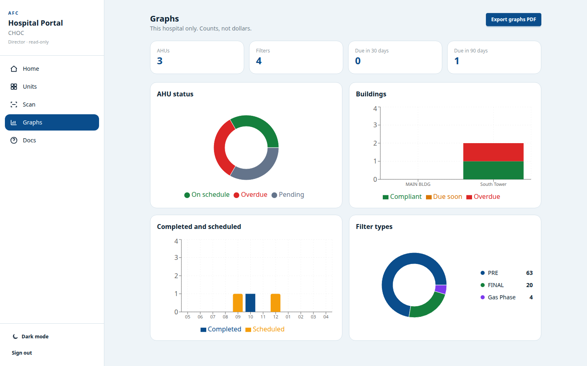
Graphs for the meeting. Counts, not dollars.
6 / 9
AFC Hospital Portal · For hospital directors · 323.832.8316
Notes:
Director-only. Floor techs do not get this page. Export graphs PDF. This hospital only. Not a Joint Commission record — say that if Quality is present. Filter types are quantities of PRE / FINAL / gas phase, not a shopping list.

Slide 7
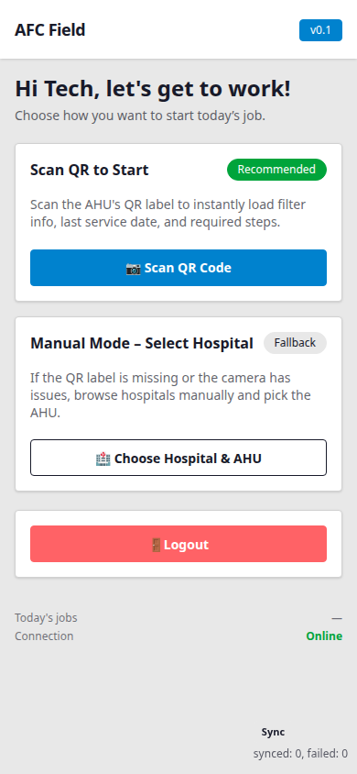
What AFC is doing on the roof
7 / 9
AFC Field is our technician app — not yours.
▸ Our tech scans the same sticker you will scan.
▸ They see the job: sizes, quantities, last service, what to change.
▸ When they complete the changeout, last-serviced and next-due update.
▸ That is what feeds your portal. You do not re-enter it.
▸ If the penthouse has no signal, they still finish the job. It uploads when they are back online.
AFC Hospital Portal · For hospital directors · 323.832.8316
Notes:
Keep this short. You are not training them on Field. The point is trust: the portal is not a second spreadsheet your staff has to type. AFC’s completed job is the source, and the portal is the window.

Slide 8
Built so you can look. Not so you can break it.
8 / 9
Read-only
No one at the hospital can edit filters, due dates, or the survey.
No prices
Invoices, POs, and catalog dollars stay with AFC.
Your hospital
A login cannot open another facility. Ours cannot be switched from the browser.
Two hospital roles
Directors get home, graphs, and the IT packet. Floor techs get units and scan.
Not patient data
AHU names and PM dates. Not an EHR. Not PHI.
IT packet on request
Docs → Download PDF for Information Security. Voice: 323.832.8316.
AFC Hospital Portal · For hospital directors · 323.832.8316
Notes:
This slide calms IS and the director who is afraid staff will ‘mess up the filters.’ Floor techs cannot open graphs. No PHI claim — don’t oversell HIPAA. Packet exists if they want it filed.

Slide 9
You see the status. AFC does the work.
Scan the sticker on the unit.
Open the portal on a phone or a desktop.
Walk into the next meeting with live counts — not a forwarded spreadsheet.
AFC Hospital Portal · 323.832.8316
Notes:
Stop. Offer a live scan if you brought a sticker. Offer a director login for their hospital if accounts are already issued. If they ask SSO/MFA, be honest: not offered; IT packet states the gap.

